Slide 1

University of Dhaka
Institute of Information Technology
TEXT
SUMMARIZER
Program: Master in Information Technology
Course Name: Advanced Object Oriented Programming

Slide 2
Project: Text Summarizer
Submitted To
Dr. Mohammed Shafiul Alam Khan
Associate Professor and Director
Institute of Information Technology,
University of Dhaka.
Submitted By
Group no. : 02
Group Members:
Md. Siam Ansary
ID: 201103
Email: siamansary.cse@gmail.com
Kanok Chanpa Saha Bhowmik
ID: 201120
Email: rinky.saha360@gmail.com
Atonu Saha
ID: 201127
Email: atonuewu@gmail.com
Umme Kawser Sinthia
ID: 201136
Email: sinthy08@gmail.com

Slide 3
Outline
Database
Package Diagram
Class Diagram
Limitations
References
Automatic Text Summarization
Categories of Text Summarization
Object Oriented Programming
Selected Research Works
Implementation Approach
Implementation Aspects

Slide 4
Automatic Text Summarization
Summary ?
Concise representation of document(s)
Include all necessary data
Must not exclude any crucial points
Why do we need Summarization?
Presence of huge textual data
Lack of human resource

Slide 5
Categories of Text Summarization
Text Summarization
Extractive Summarization
Abstractive Summarization

Slide 6
Categories of Text Summarization
Text Summarization
Extractive Summarization
Abstractive Summarization

Slide 7
Object Oriented Programming
Software design around data or object
Objects having unique attributes and behavior
Well suited for complex applications

Slide 8
Selected Research Works
“Automatic Document Summarization using Sentiment Analysis”
Prioritization of neutral sentences
“Using Sentiment-Analysis for Text Information Extraction”
Prioritization of fragments with highest emotional charge
“An Algorithm for Summarization of Paragraph Up-to One Third with the Help of Cue Words Comparison”
Sentence scoring features be adjusted with sentence length

Slide 9
Implementation Approach
Sentence Length Analysis
Sentiment Analysis

Slide 10
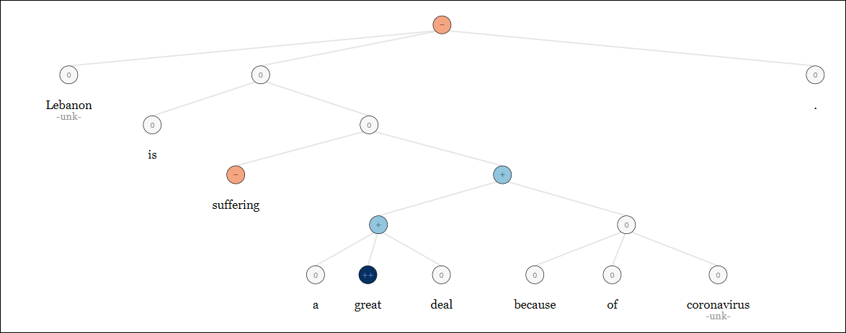
Implementation Approach (Contd.)
Sentiment Analysis:
Stanford NLP libraries
Use of complex recursive neural network
Sentiment types
Very negative
Negative
Neutral
Positive
Very positive
Sentence: Lebanon is suffering a great deal because of coronavirus.
Parse tree generated at http://nlp.stanford.edu:8080/sentiment/rntnDemo.html

Slide 11
Implementation Approach (Contd.)
Sentiment Analysis
Stanford NLP libraries
Use of complex recursive neural network
Sentiment types
Very negative
Negative
Neutral
Positive
Very positive

Slide 12
Implementation Approach (Contd.)
Main Thread
Input Text
Two user threads to identify candidate summary sentences
Identify candidate summary sentences based on sentence length
Identify candidate summary sentences based on sentiment type
1st user Thread
2nd user Thread
Main Thread
Form Summary with sentences that fulfill both criteria
Figure: Use of multi-threading for summarization

Slide 13
Implementation Aspects
User registration and log in
Input for summarization
Summary generation
Generated summary storing

Slide 14
Database
Database Tables
H2 database
Free SQL database
Written in Java
USERS
userid
firstname
surname
username
password
SUMMARIES
summaryid
username
subject
identification
date
input
output

Slide 15
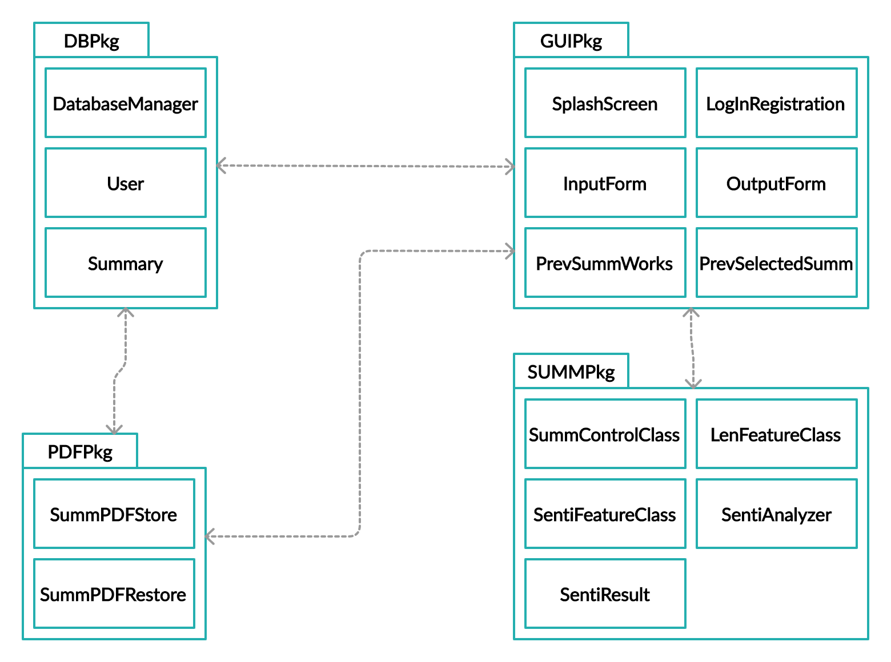
Package Diagram

Slide 16
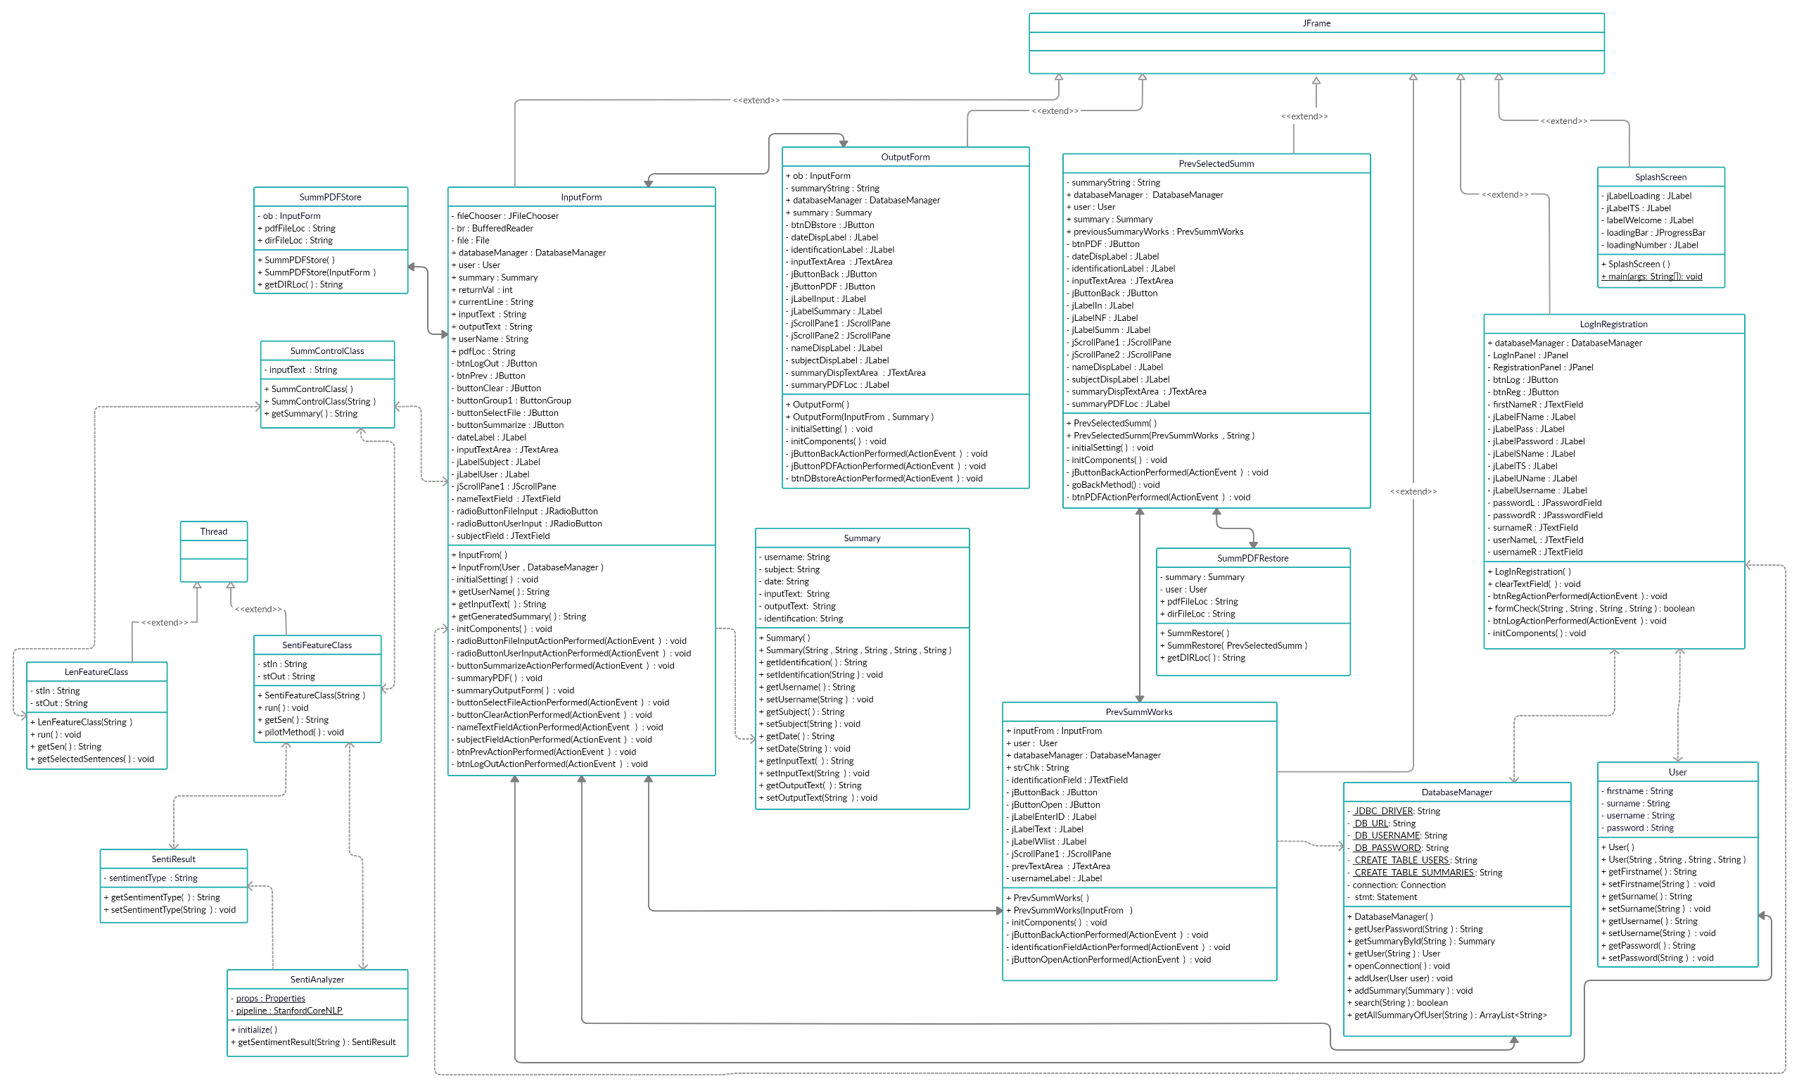
Class Diagram

Slide 17
Limitations
Limited Input Formats
Limited Criteria for Summarization
Limited Accuracy of Generated Summaries
Local Database

Slide 18
References
Salil Dabholkar, Yuvraj Patadia and Prajyoti Dsilva, “Automatic Document Summarization using Sentiment Analysis”, in Proceedings of 2016 International Conference on Informatics and Analytics (ICIA), August, 2016, Pondicherry, India.
Solov’ev A.N., Antonova A.Ju. and Pazel’skaia A.G., “Using Sentiment-Analysis for Text Information Extraction”, in proceedings of the 2012 Computational Linguistics and Intelligent Technology, pp. 616-627, August, 2012, Moscow, Russia.
Noopur Srivastava and Bineet Kumar Gupta, “An Algorithm for Summarization of Paragraph Upto One Third with the Help of Cue Words Comparison”, International Journal of Computer Science and Applications, Volume 5, No. 5, pp. 167-171, 2014, United Kingdom.
“The Stanford Natural Language Processing Group”, https://nlp.stanford.edu/ , Last accessed August 9, 2020

Slide 19
Thank You!!!
Any Questions?

